Slide 1

Basic Details of the Team and Problem Statement.
Ministry/Organization Name/Student Innovation:
AICTE, MIC-Student Innovation
PS Code:SIH1494
Problem Statement Title: Student Innovation
Team Name: BROGRAMMERS
Team Leader Name: Anak
Institute Code (AISHE): U0809
Institute Name: Bennett University
Theme Name: BENNEFIT (FIT AND HEALTHY INDIA)

Slide 2
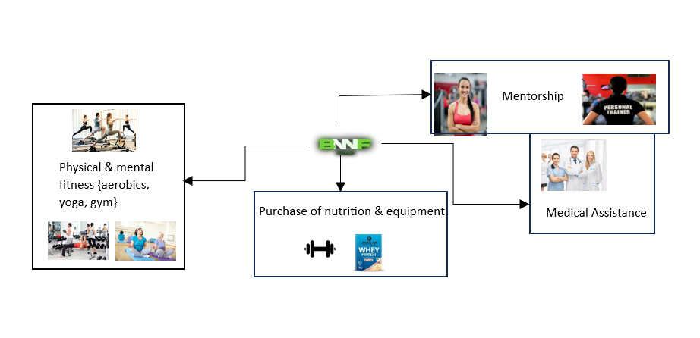
Idea/Approach Details
IDEA / SOLUTIONS:
The purpose of a BENNEFIT is to provide the user with instructions and examples of one or more types of exercise, physical activity, nutritional programs, or some other fitness topic.
Accessible for underweight and overweight people because of BMI usage , it provides proper set of instructions to be followed.
Mental health is taken care of under the guidance of yoga instructors with proper asanas.
One to one mentorship: One can access the services of fitness trainers for personal training.
TECHNOLOGY STACK
Python: BMI Index
HTML: Web Page
CSS: Animation and Styling
JAVA SCRIPT: Dialogue Box
PRODUCT STATUS :
60% of the website is made. Backend is not present in the website. The website is under further tests.

Slide 3
Idea/Approach Details
USE CASES:
SHOWSTOPPER:
Easily accessible: The software is user friendly with basic language used.
Boon for Senior Citizens: It monitors the health of elders and provide appropriate exercise routine for them.
Moderate Bandwidth required: The website can be accessible in low to moderate network areas and can function properly.
Good quality products: The proteins and equipment sold are of premium quality and trusted by users.
Disease Test: With the portal of checking one’s diabetes symptoms and BMI.
BENNEFIT fitness band: This fitness band will record your health index including heartrate, SO2 INDEX and physical fitness improvement.
Cross Device Support: Works perfectly even for feature phones , iOS as well as Android.
Doctor’s guidance: The website provides the service to access physiotherapist’s diagnosis and other doctors as well.
Channels: Web browsers of all kind.
REVENUE: Premium accounts, Purchase of equipment.

Slide 4
Team Members Details
Team leader name: Anak Vyas
Branch: BTECH Stream: CSE Year: I
Team Member 1 Name: Yash Joshi
Branch: BTECH Stream: CSE Year: I
Team Member 2 Name: Ayush Aryan
Branch: BTECH Stream: CSE Year: I
Team Member 3 Name: Pranjal Srivastava
Branch: BTECH Stream: CSE Year: I
Team Member 4 Name: Pal Pandya
Branch: BTECH Stream: CSE Year: I
Team Member 5 Name: Khushi Saroha
Branch: BTECH Stream: CSE Year: I

